Slide 1
SEARCHING
Unit 2.6

Slide 2
Introduction
Search can be viewed abstractly as a process to determine if an element with a particular value is a member of a particular set.
Searching refers to finding out whether a particular element is present in the list or not.
Search algorithms are algorithms that find one element of a set by some key containing other information related to the key.
If the list is an unordered list, then we use linear or sequential search, whereas if the list is an ordered list, then we use binary search.

Slide 3
Searching Terminologies
Internal key
  Key is contained within the record at a specific offset from the start of the record
External Key
  There is a separate table of keys that includes pointers to the records
Primary Key
  The key used to search is unique for every record in the table
Secondary Key
  Same key may be associated with more than one record in the table

Slide 4
Searching Terminologies
Search algorithm
  Accepts an argument and tries to find a record in a given table whose key it matches
Successful search
  Algorithm finds at least one record
Unsuccessful search
  Algorithm doesn’t find any records
Retrieval
  A successful search is often called retrieval
Internal Searching
  Records to be searched are sorted entirely within computer main memory
External Searching
  For large records we need external storage devices and we search on such devices.

Slide 5
Searching Algorithms
Basically there are two categories of searching algorithms
  Sequential Search or Linear Search
  Binary Search

Slide 6
Linear or Sequential Search
This the simplest method for searching, in this method the element to be found is searched sequentially in the list.
This method can be used on a sorted or an unsorted list.
In case of a sorted list searching starts from 0th element and continues until the element is found or the element whose value is greater than the value being searched is reached
Searching in case of unsorted list starts from the 0th element and continues until the element is found or the end of the list is reached.

Slide 7
Linear or Sequential Search
The list given above is the list of elements in an unsorted array.
The array contains 10 elements, suppose the element to be searched is 46 then 46 is compared with all the elements starting from the 0th element and searching process ends where 46 is found or the list ends.
The performance of the linear search can be measured by counting the comparison done to find out an element.
The number of comparisons is 0(n)

Slide 8
Binary Search
Binary search technique is very fast and efficient. It requires the list of the elements to be in sorted order.
The logic behind this technique is given below:
  First find the middle element of the array
  compare the middle element with an item.
  There are three cases:
    If it is a desired element then search is successful
    If it is less than desired item then search only the first half of the array.
    If it is greater than the desired element, search in the second half of the array.
Repeat the same process until element is found or exhausts in the search area.
In this algorithm every time we are reducing the search area.
We can apply binary search technique recursively or iteratively

Slide 9
Recursive Binary Search
As the list is divided into two halves, searching begins
Now we check if the searched item is greater or less than the center element.
If the element is smaller than the center element then the searching is done in the first half, otherwise it is done in the second half
The process is repeated till the element is found or the division of half parts gives one element.

Slide 10
Recursive Binary Search
Let a[n] be a sorted array of size n and x be an item to be searched. Let low=0 and high=n-1 be lower and upper bound of an array
If (low>high)
  return 0;
mid=(low+high)/2;
if (x==a[mid])
  return mid;
if (x<a[mid])
  Search for x in a[low] to a[mid-1];
else
  Search for x in a[mid+1] to a[high];

Slide 11
0 | 1 | 2 | 9 | 10 | 11 | 15 | 20 | 46 | 72
We need to search 46, we can assign first=0 and last= 9 since first and last are the initial and final position/index of an array
The binary search when applied to this array works as follows:
  Find center of the list i.e. (first+last)/2 =4 i.e. mid=array[4]=10
  If higher than the mid element we search only on the upper half of an array else search lower half. In this case since 46>10, we search the upper half
    i.e. array[mid+1] to array [n-1]
  The process is repeated till 46 is found or no further subdivision of array is possible

Slide 12
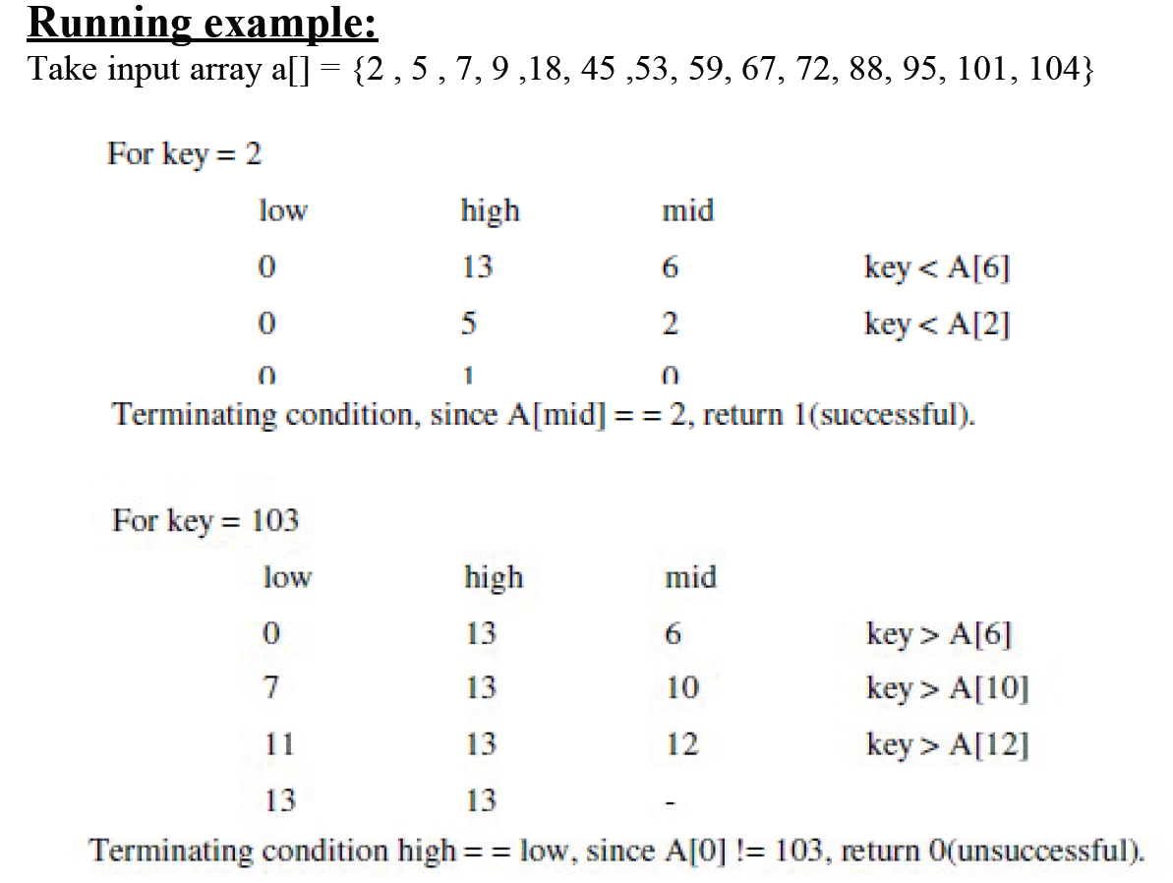

Slide 13
Iterative Binary Search Algorithm
The recursive algorithm is inappropriate in practical situations in which efficiency is a prime consideration.
The non-recursive version of binary search algorithm is given below.
Let a[n] be a sorted array with size n and key is an item being searched for.

Slide 14
Algorithm
low=0; hi=n-1;
while(low<=hi){
mid=(low+hi)/2;
if(key==a[mid])
return mid;
if (key<a[mid])
hi=mid-1;
else
low=mid+1;
}
return 0;

Slide 15
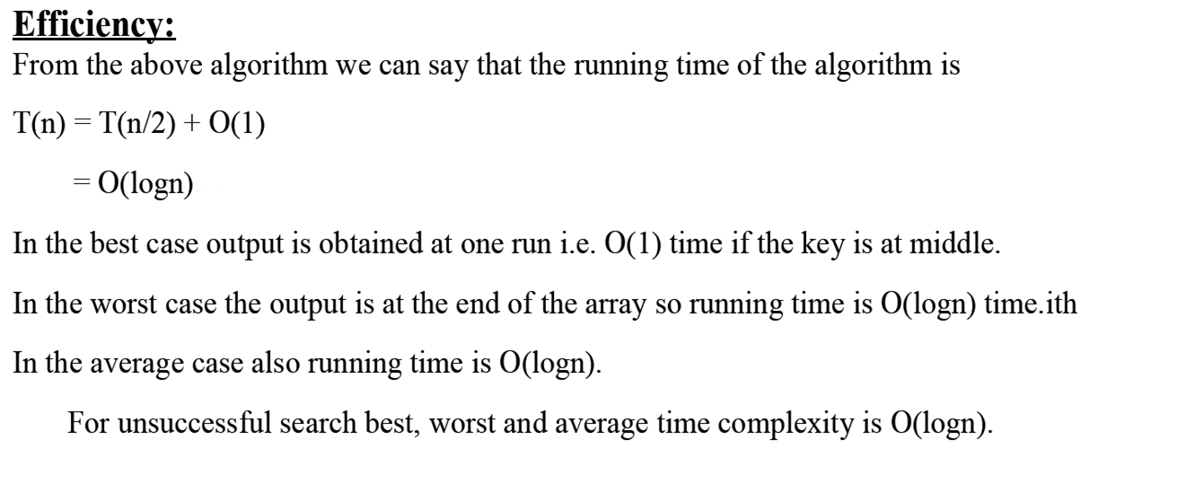

Slide 16
Comparison of sequential and binary search algorithm
Sequential Search | Binary Search
Time complexity: 0(n) | Time complexity: 0(logn)
Only eliminates one element from the search per comparison | Eliminates half of the array elements for each comparison
As n number of elements gets very large, sequential search has to do lot more work | As n number or elements gets very large, binary search has to do little work than sequential search
Has to search each element i,i+1,i+2,i+3…….n | Has to search n/2,n/4,n/8….1 elements
Doesn’t require element to be in sorted order | Requires elements to be in sorted order
Easy to program but takes too much time | Easy to program and execution time faster

Slide 17
Application of Search Algorithms
Search Engines
Online enquiry
Text Pattern matching
Spell Checker
Ant algorithm

Slide 18
Hashing Introduction
Now the only problem at hands is to speed up searching.
Consider a problem of searching an array for a given value.
If array is not sorted, need to search each and every elements
If array is sorted, binary search whose worse-case runtime complexity 0(logn)
We could search even faster if we know in advance the index at which that value is located in the array.
We could use some magic function where our search would be reduced to a constant runtime 0(1). Such magic function is called hash function.
A hash function is a function which when given a key, generates an address in the table

Slide 19
Hashing
The process of mapping large amounts of data into a smaller table is called hashing.
Hashing is relatively easy to program as compared to tree however it is based on arrays, hence difficult to expand
It performs insertions, deletions and finds in constant average time.

Slide 20
Hash Table
A hash table is a data structure where we store a key value after applying the hash function, it is arranged in the form of an array that is addressed via a hash function.
The hash table is divided into number of buckets and each bucket is in turn capable of storing a number of record.
Thus we can say that a bucket has a number of slots and each slot is capable of holding one record
The time required to locate any element in the hash table is 0(1).
Now the question may arise how do we map number of keys to a particular location in the hash table. i.e. h(k). It is computed using hash function

Slide 21
Array Items: 21, 56, 72 ,39, 48,96,13….
Hash Table
0
1 | 21
2
3
4
5
6 | 56
7
8
9
H(x) =x mod 10
H(21) = 21 mod 10 = 1
H(56) = 56 mod 10 = 6
H(72)=….
H(39)=….

Slide 22
Hash Function
A function that transforms a key into a table index is called a hash function
If h is a hash function and k is a key) is called the hash of key and is the index in which a record with the key k should be placed.
The basic idea in hashing is the transformation of a key into the corresponding location in the hash table. This is done by hash function.
It is usually denoted by H
H: K -> M
where, H=hash function
K= set of keys
M=set of memory address

Slide 23
Hash Functions
Sometimes, such function H may not yield distinct values, It is possible that two different keys K₁ and K₂ will yield the same hash address.
This situation is called Hash Collision
To choose the hash function H:K->M there are two things to consider.
  First the function H should be very easy and quick to compute.
  Second, H should distribute the keys to the number of location of hash table with less no of collisions
Some hash functions:
  Division reminder method
  Mid square method
  Folding method

Slide 24
Division Reminder Method
In this method, key k is divided by a number m larger than the number n or keys in k and the reminder of this division is taken as index into the hash table i.e.
h(k)=k mod m
The number m is usually chosen to be a prime number or a number without small divisors, since this frequently minimizes the number of collisions

Slide 25
Division Reminder Method
Consider a hash table with 7 slots i.e, m=7, then hash function
h(k)= k mod n will map the key 8 into slot 1 since
h(8)=8 mod 7 =1 is mapped to slot 1,
h(13)=13 mod 7 = 6 is mapped to slot 6 and so on.

Slide 26
Mid Square Method
In this method the key is first squared. Therefore the hash function is defined by h(k) =p, where p is obtained by deleting digits from both sides of k².
To implement this the same position of k² must be used for all the keys.
Ex: consider a hash table with 50 slots i.e m=50 and key values k =1632,1739,3123.
Solution:
k = 1632
k² = 2663424
h(k) = 34

Slide 27
Folding Method
In this method the key, k is partitioned into a number of parts k1,k2….kr where each part, except possibly the last, has the same number of digits as the required address.
Then the parts are added together, ignoring the last carry i.e.
H(k)= k1+k2+…..+kr

Slide 28
Hash Collision
hash collision is the process in which more than one key is mapped to the same memory allocation in the table.
For example, if we are using the division reminder hashing:
h(k) = k%7
Then key =8 and key =15 both mapped to the same location of the table
h(k) = 8 % 7 = 1
h(k) = 15 % 7 =1
Two most common methods to resolve the hash collision are as follows:
  Hash collision resolution by separate chaining
  Hash collision Resolution by Open Addressing

Slide 29
Hash collision resolution by separate chaining
In this method all the elements where keys hash to the same hash-table slot are put in one linked list
Therefore the slot in the hash table contains a pointer to the head of the linked list

Slide 30
Hash collision Resolution by Open Addressing
In open addressing the keys to be hashed is to put in the separate location of the hash table.
Each location contains some key or the some other character to indicate that the particular location is free
Some popular methods
  Linear probing
  Quadratic probing
  Double Hashing
  Rehashing

Slide 31
Linear probing
A hash-table in which a collision is resolved by putting the item in the next empty place within the occupied array space
It starts with a location where the collision occurred and does a sequential search through a hash table for the desired empty location
Hence the method searches in straight line, and it is therefore called linear probing.

Slide 32
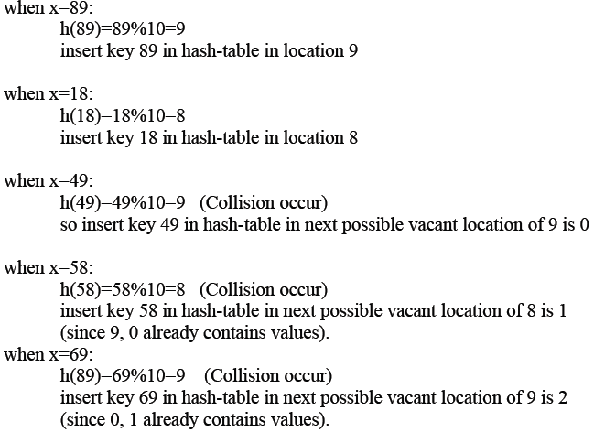
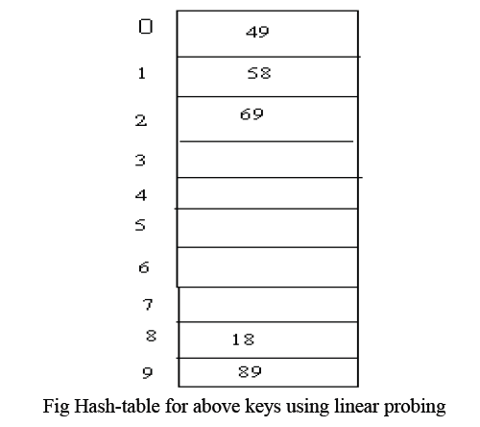
Example: insert keys {89,18,49,58,69} with the hash function h(x) = x mod 10 using linear probing

Slide 33
Quadratic probing
Quadratic probing is a collision resolution method that eliminates the primary collision problem.
When collision occur then the quadratic probing works as follows:
(Hash value +1²) % tablesize
If there is again collision then there exist rehashing
(Hash value +2²) % tablesize
If there is again collision then there exist rehashing
(Hash value +3²) % tablesize
Same goes again, in i^{th} collision
h(x) =(hash value + i²) % tablesize

Slide 34
